Slide 1
Go Pokémon Go!
Exploring the world of one of the most globally beloved games
Notes:
Slides shared by Kasim
Sara intros: Good evening! We’re group 9 here to present the World of Pokémon! Join us as we explore one of the most globally beloved games

Slide 2

Meet the Team
Sara McLean:
HTML Coding, Website Development, PowerPoint
Vanessa Lee:
DB, Flask API, Heatmap Chart
Serafin Juarez:
DB, Flask API, Bar Chart, Pokémon SME
Kasim Ahmad:
DB, PG Admin, Jupyter NB Table Development, Flask API
Daniel Rossi:
Radar Chart, JS Library integration
Notes:
Sara
Joining me tonight is Vanessa, who will highlight her heatmap chart, Serafin, who will highlight his bar chart, Kasim, who will feature all the database and Flask API work and Daniel who will display his radar chart. Now I’ll hand it over to Serafin to discuss the project’s purpose.

Slide 3
Project Scope and Purpose
The Pokémon franchise started as a series of games developed by Gamefreak that has grown to become a global phenomenon and is currently celebrating the 25th anniversary in 2021.
The concept of the Pokémon Universe, in both the video games and the general fictional world of Pokémon, stems from the hobby of insect collecting, a popular pastime which the creator, Tajiri, enjoyed as a child.
Join us in exploring the world of Pokémon! This internationally beloved game is a staple of gamers everywhere and our project explores the game, highlights some history, characters and territories of this complex game.
Our webpage is designed to be user friendly with various drop-down menus and character backgrounds. We believe is a great tool for both beginners and advanced users of Pokémon.
Notes:
Serafin

Slide 4
Data Sets and Process
Sourced from Kaggle
Pokedex_0420.csv
Pokedex_0520.csv
Python Pandas Library
Postgres SQL
Flask API
Notes:
Kasim

Slide 5
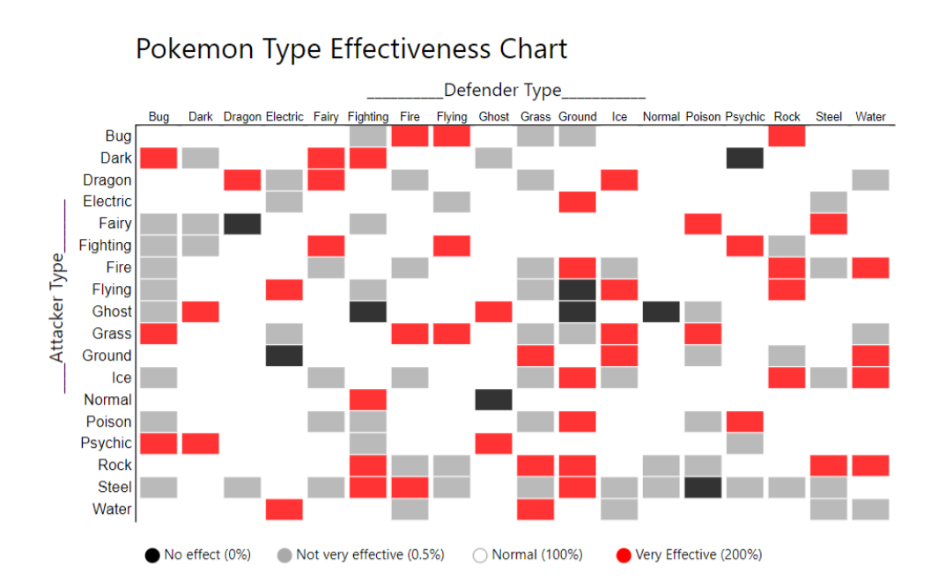
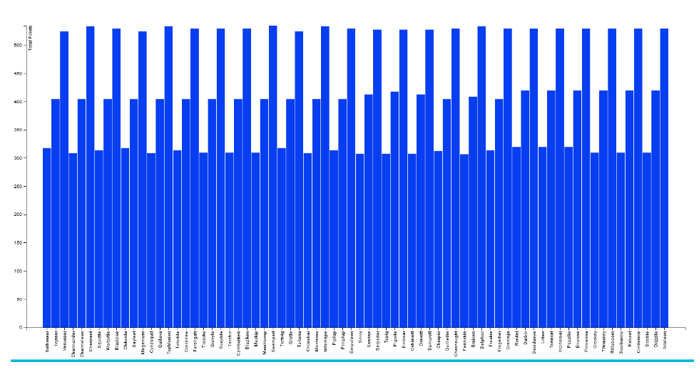
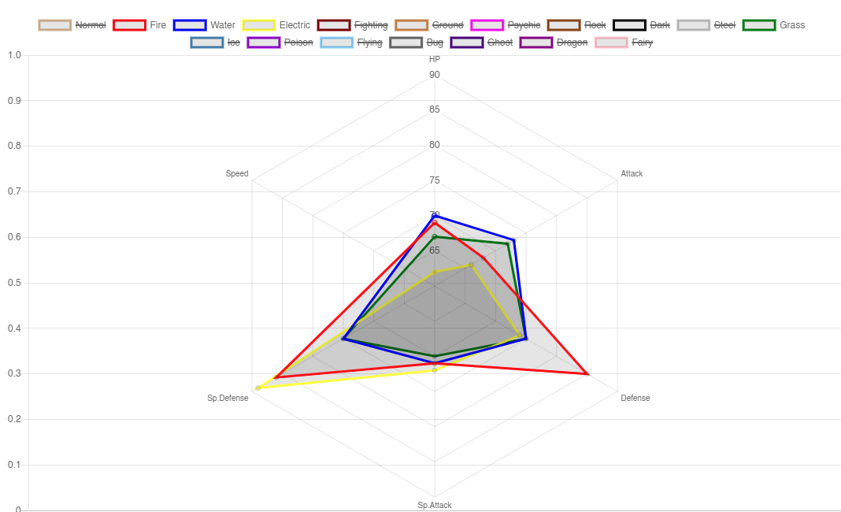
JavaScript Visualizations
Heatmap
Pokémon typing & effectiveness – Displays:
Normal Effective match-ups
Super Effective match-ups
Not-very effective match-ups
No effect match-ups
Bar Chart
Total base stats comparison between starters of all generations
Radar Chart
Average of stats per type breakdown
Notes:
Kasim

Slide 6

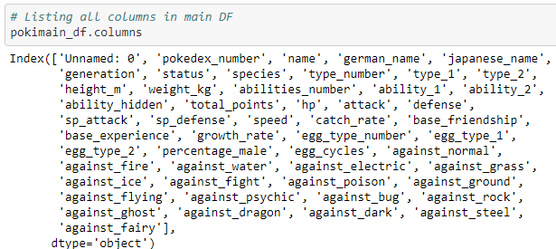
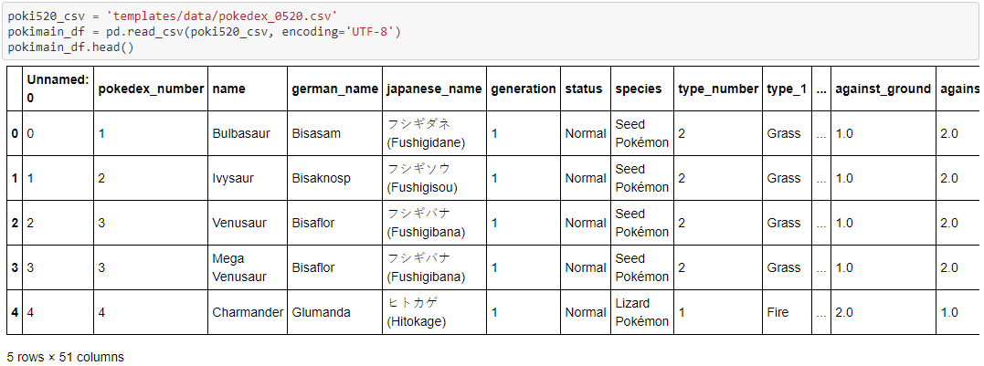
Source Dataset
Summarized Key Columns in Original Dataset:
Pokedex number
Name
Generation
Type
[STAT INFORMATION]
[EFFECTIVENESS]
Notes:
Kasim

Slide 7
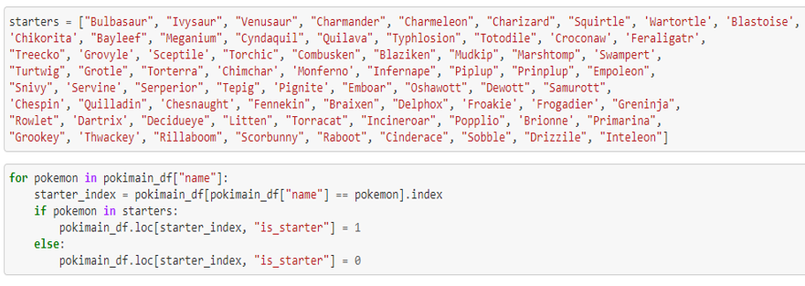
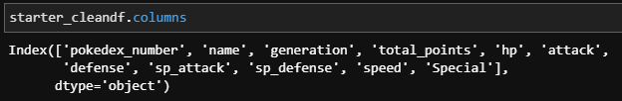
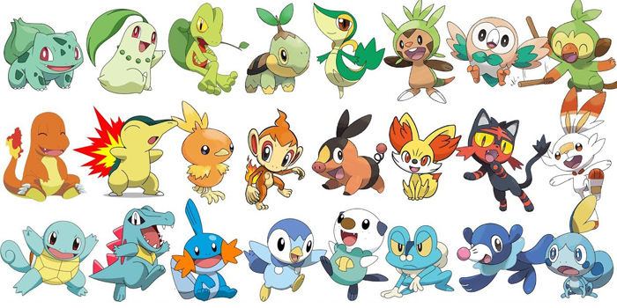
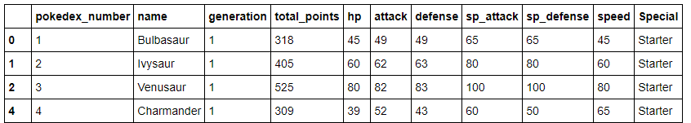
Pandas Data Cleaning – Starter Data
Specified starters by values in “name” column:
Looped through list with a
Boolean value in a custom column:
Final column to exported to PostgreSQL:
Notes:
Kasim

Slide 8
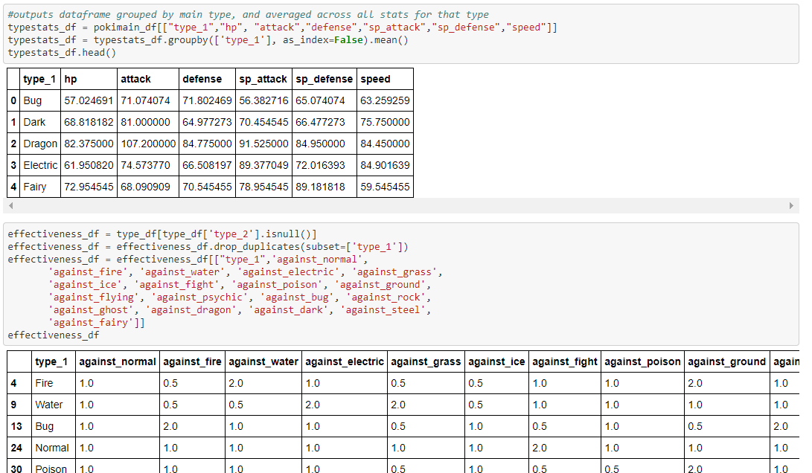
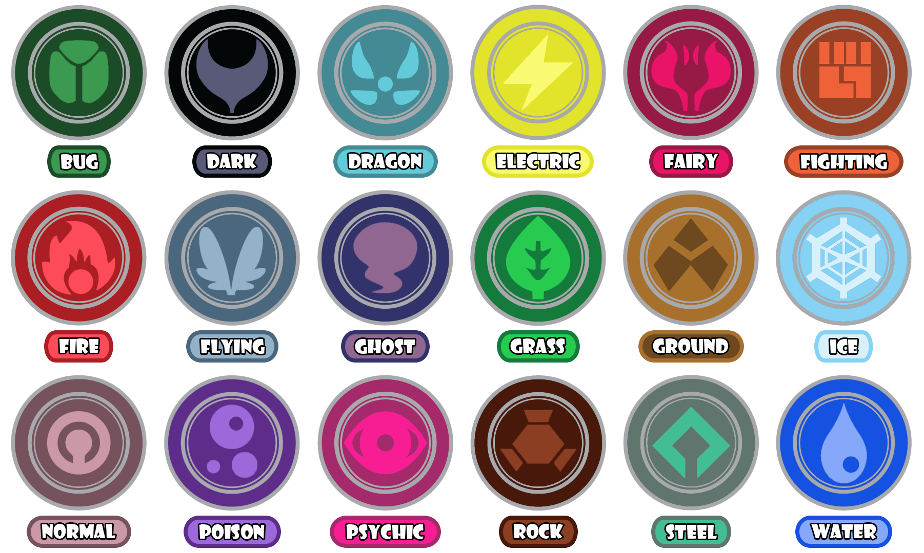
Pandas Data Cleaning – Type & Effectiveness
Typing grouped and stat
averages:
Singular typing and effectiveness:
Notes:
Kasim

Slide 9

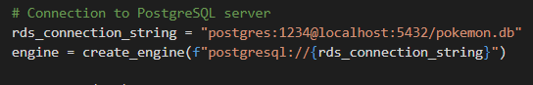
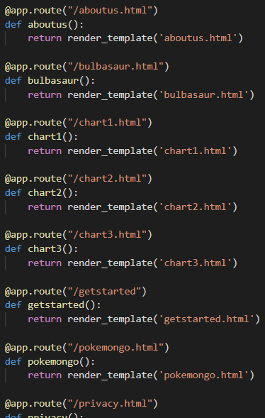
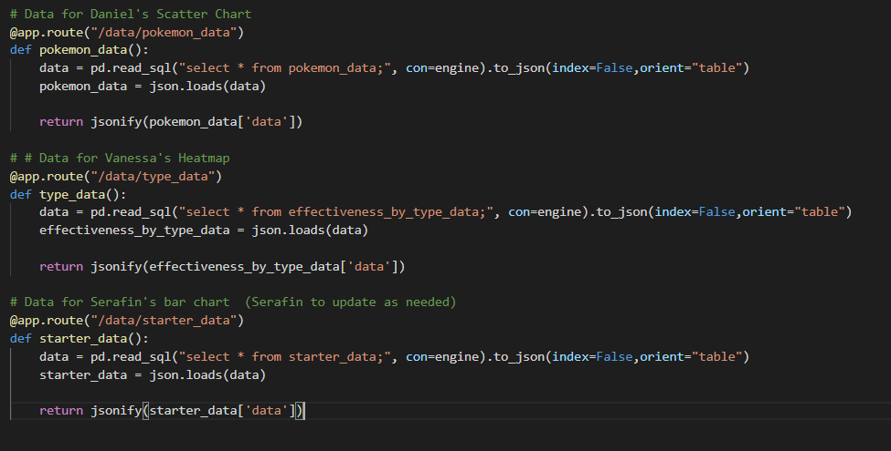
PostgreSQL connection + Flask
Notes:
Kasim

Slide 10
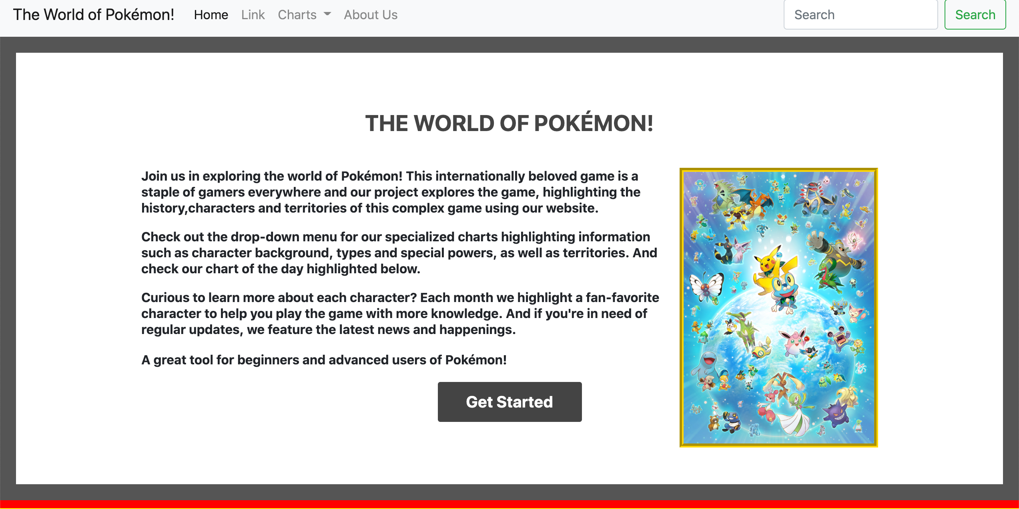
HTML Website Development
HTML – 11 landing pages
Interactive site using dropdown navigation
Bootstrap
CSS folder with 3 CSS files
Images folder
Home Page Intro Section
Notes:
Sara
Highlighting the HTML development, there are 11 landing pages on this interactive website with a variety of styling and formatting features to engage the user

Slide 11
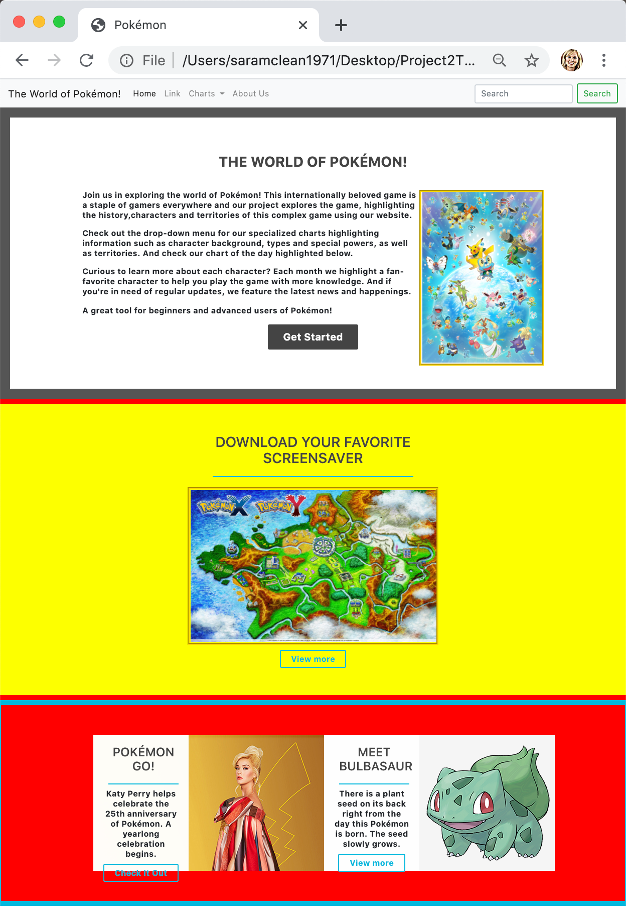
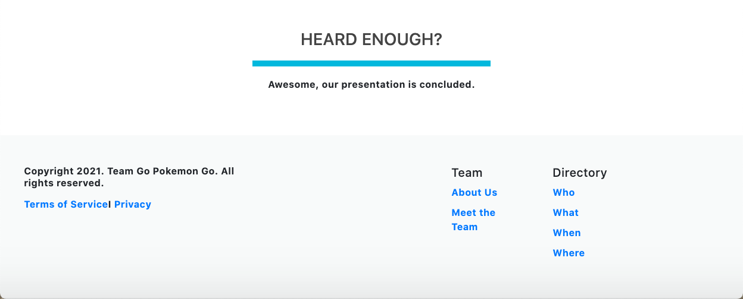
HTML Website Overview
Theme: Pokémon
Long form format
Multiple interactive sections including:
Website Introduction
Download your Favorite Screensaver
Meet a Character
Pokémon GO! Latest news
Footer section with terms, privacy, team information
Notes:
Sara
The theme of Pokémon is threaded throughout this long form format website. The multiple interactive sections include the features section along with an introduction and history of the game, an activity section where this month we’re highlighting a link to download your favorite screensaver and an article monthly features section, regularly updated to show the latest news such as the 25th anniversary of pokemon this year, along with a Meet a Character article where we highlight a new character each month, this month we feature Bulbasaur. At the bottom, we have a footer section following current website formats.

Slide 12
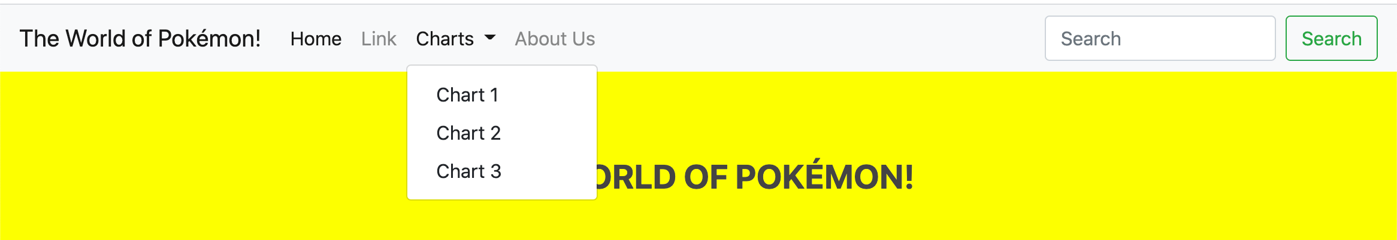
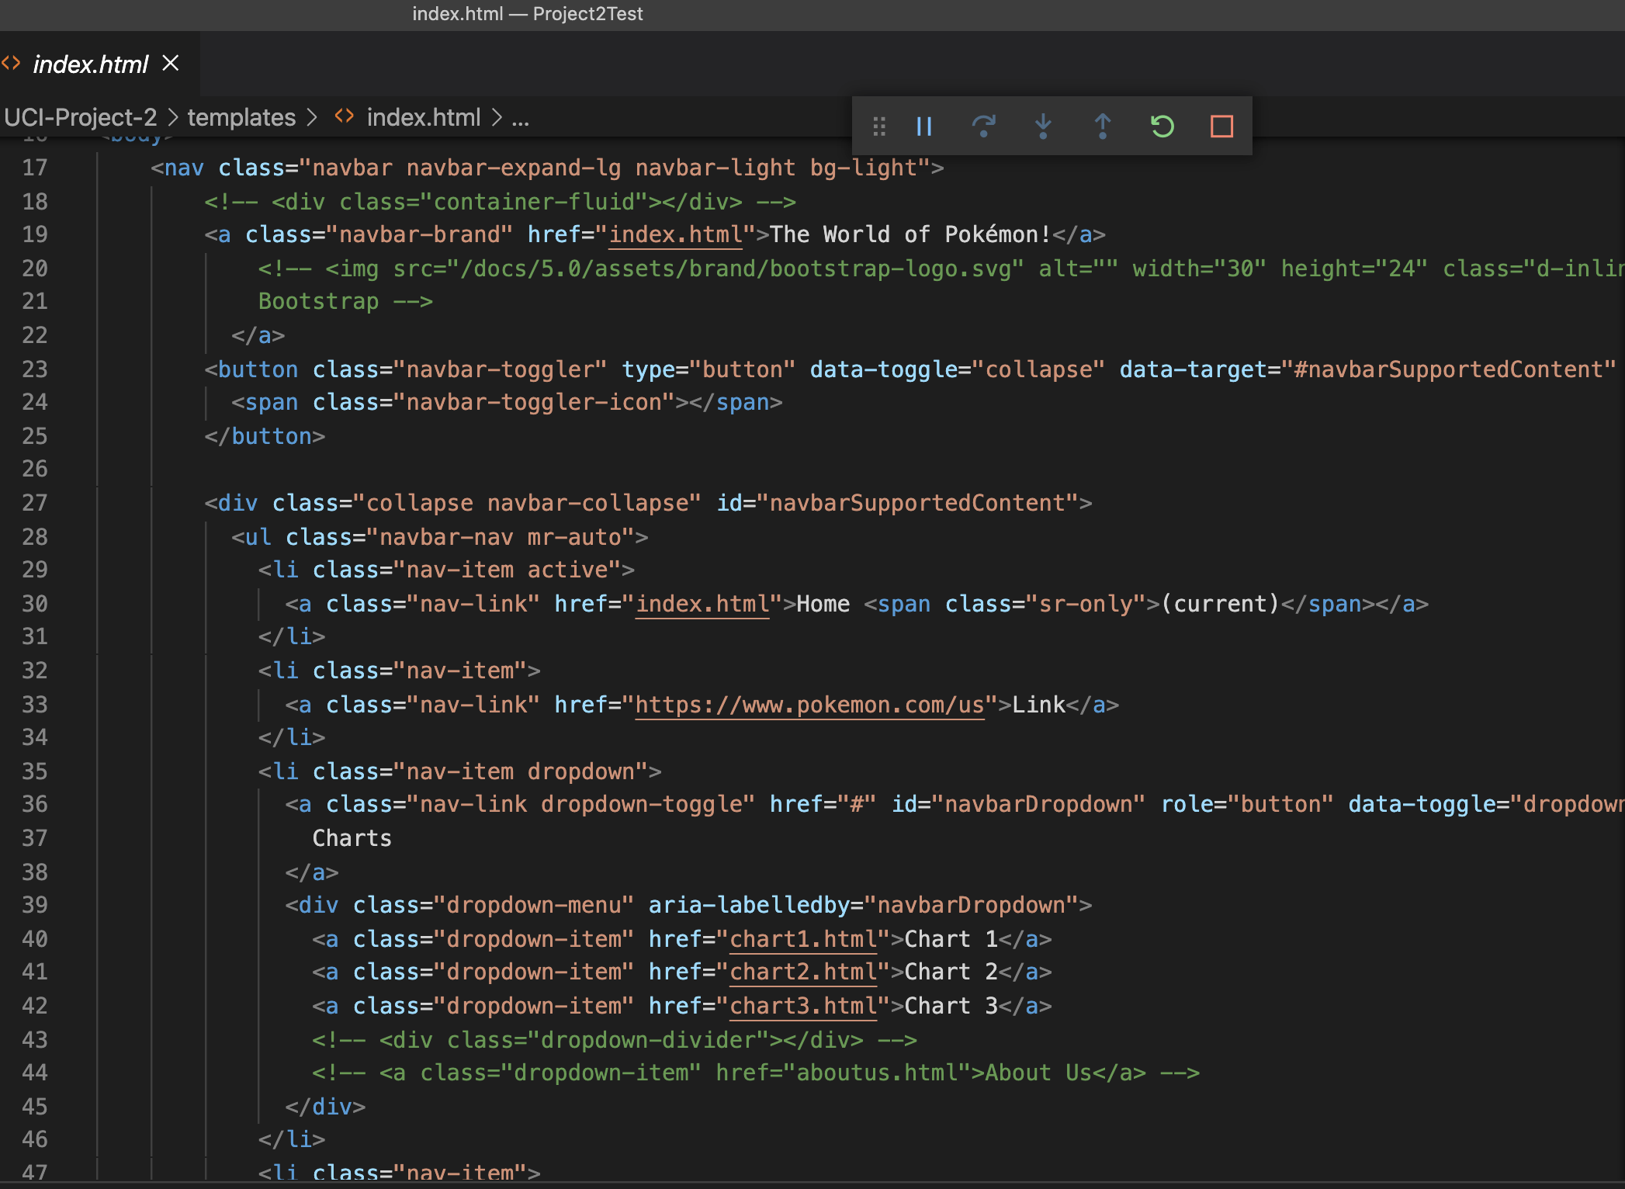
HTML Code – Top Nav
Navigation Bar HTML Code
Utilized Bootstrap nav to set up top navigation
Toggle method between each page
Dropdown menu with 3 chart pages for team
Notes:
Sara
Now we’ll go back to the top navigation and head over the drop down menu for our charts review, beginning with Serafin.

Slide 13
Bar Chart
D3-JS powered bar chart
Flask driven D3.JS Bar Chart:
Data consists of 2 of 11 available columns:
Pokémon's name and the total power (Sum of the Attack points, Defense points, Hit points (hp), Special Attack points, Special defense points and the Pokémon's Speed.
Pokémon are sorted by the Pokédex number and Generation.
Tooltip:
Color swap on bar selection for Pokémon.
Notes:
Serafin

Slide 14
Radar Chart
Chart.js powered radar plot
JS code embedded within HTML script tags
Data consists of 6 columns:
HP, Attack, Defense, Sp. Attack, Sp. Defense, Speed
Type data averaged across primary class of each Pokémon
Color coded line colors to match each Pokémon Type
Filter Function:
Types can be added or hidden by clicking legend icons
Tooltip:
Tooltip function highlights type and stat being selected
Notes:
Daniel

Slide 15
Heatmap
D3-JS powered heatmap
JS code embedded within HTML script tags
HTML part of the code contains a div that is modified by d3
Data consists of 3 columns:
row, col, value
i.e. attacker_type, defender_type, effectiveness
Built scales and axis
A scaleband() used to control the size of each square using the padding property (ranges between 0-1)
Each rectangle added by using a rect element
3 Tooltip functions:
mouseover
mousemove
mouseleave
Handmade Legend:
Each element of the legend has a specific line of code
Allows for more customization but very tedious and time-consuming to implement
Notes:
Vanessa

Slide 16
Summary
Exploring the world of Pokémon has never been so fun!
https://github.com/vlee2020/UCI-Project-2
Infusing the range of programs – Flask API, JSON, web page development, chart developments and database creation – a fully interactive site highlights the globally beloved game for both new and advanced players
DEMO!
Notes:
Daniel (Summary Slide and Transition to Kasim for Demo)

Slide 17
Project Requirements
Python-Flask power API
HTML/CSS
JavaScript
Postgres SQL
Dashboard Page with multiple charts updated from same data
JS Library outside class coverage: Chart.js
Data set with minimum 100 records
User-driven interaction – dropdowns, menus
Final visualization with minimum 3 views

